Slide 1

Notes:
Last Sunday we began our Lent to Easter sermon series, Wandering Heart: Figuring out faith with Peter. In this series, we’re following Simon Peter’s journey with Jesus. We want to be encouraged but also challenged as we prepare our hearts for the death and resurrection of Jesus. Like many of us, Peter has a wandering heart. His journey is not perfect, polished, or linear, but he is committed to Jesus as he remains tethered to the love of God.
In our first message… [NEXT SLIDE]

Slide 2
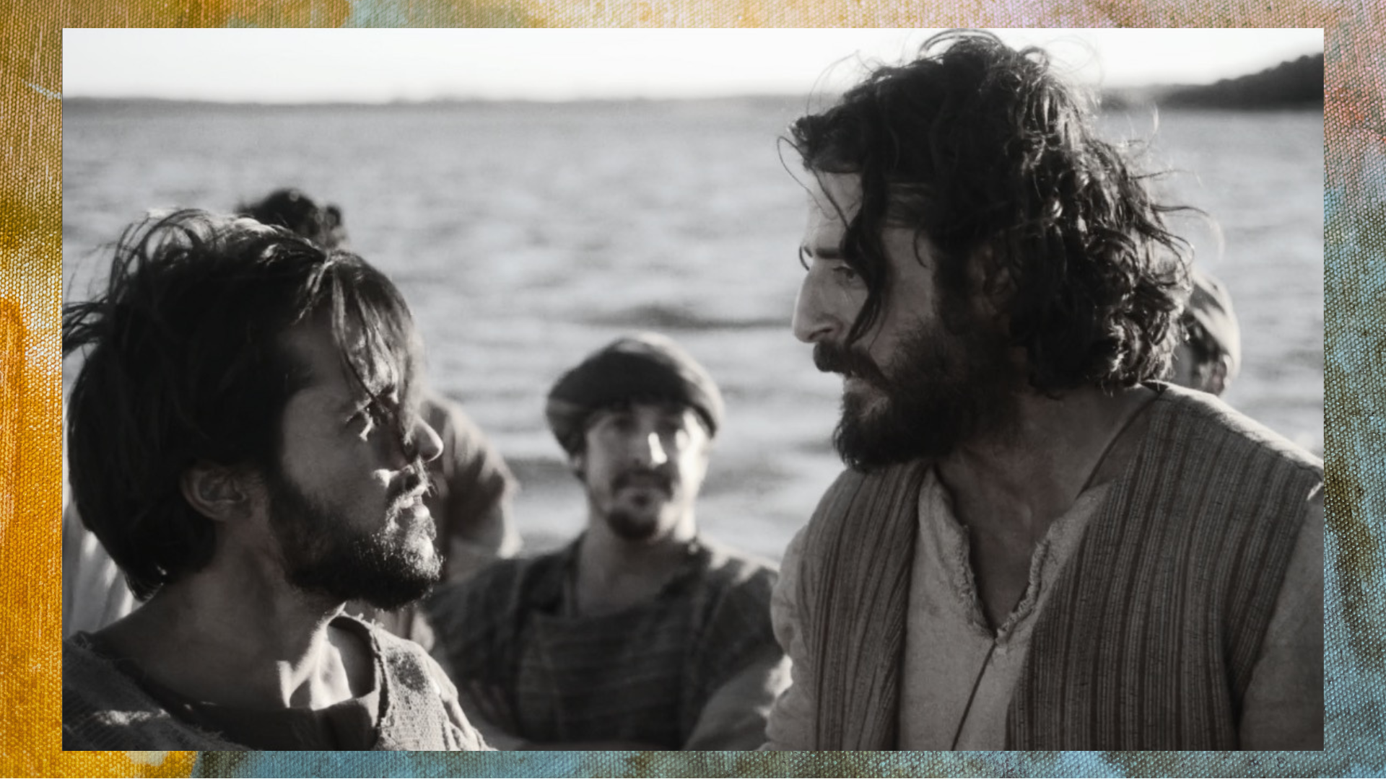
Notes:
…we were introduced to Simon, the fisherman from Capernaum in Galilee. This is some time before Jesus gives him the nickname Peter (petros-rock). You’ll recall that Simon and his brother Andrew had fished all night and caught nothing. Rabbi Jesus comes along and asks to use Simon’s boat. The Lord wanted to use it (essentially) as a platform and pulpit for a crowd that had gathered along the seashore to hear him teach.
And when he’s done teaching, he asks Simon and his companions to go out into deeper water and cast their nets. Despite his doubts about Jesus’ knowledge of fishing, Simon obeys and they are overwhelmed by a miraculous catch so great that the boat begins to sink. After this, Simon Peter realizes he is in the presence of holiness and power. He says, “Away from me, Lord, for I’m a sinful man.” And Jesus calls Simon to leave his nets and follow him, for he is now going to be fishing for people on behalf of the Kingdom of God.
Last week we focused… [NEXT SLIDE]

Slide 3

Notes:
…on how Jesus sought Peter out and he seeks us out as well. Shockingly, Rabbi Jesus welcomes all who are longing for more than this world can offer; he seeks out those that think they don’t have what it takes to be a disciple; and he chooses those who are willing to give him their heart and do whatever is necessary to follow him.
Today, in this second sermon, we’re going to look at Peter’s first big challenge. As we saw in the video clip from the popular series, The Chosen, the disciples are in a fishing boat on the Sea of Galilee when a storm hits. Jesus goes out to meet them—walking on the water! And when Jesus approaches, Simon wants to prove that he has the faith necessary to follow him and lead others. But it turns out to be both a humbling and faith-building lesson for Peter.
And so, we’re going to learn from Peter’s story and reflect on Jesus’ power to save us… in a message entitled… [NEXT SLIDE]

Slide 4

Notes:
Rescue Me from Danger.
[BRIEF PRAYER]
Please open your Bibles to our main Scripture reading… [NEXT SLIDE]

Slide 5
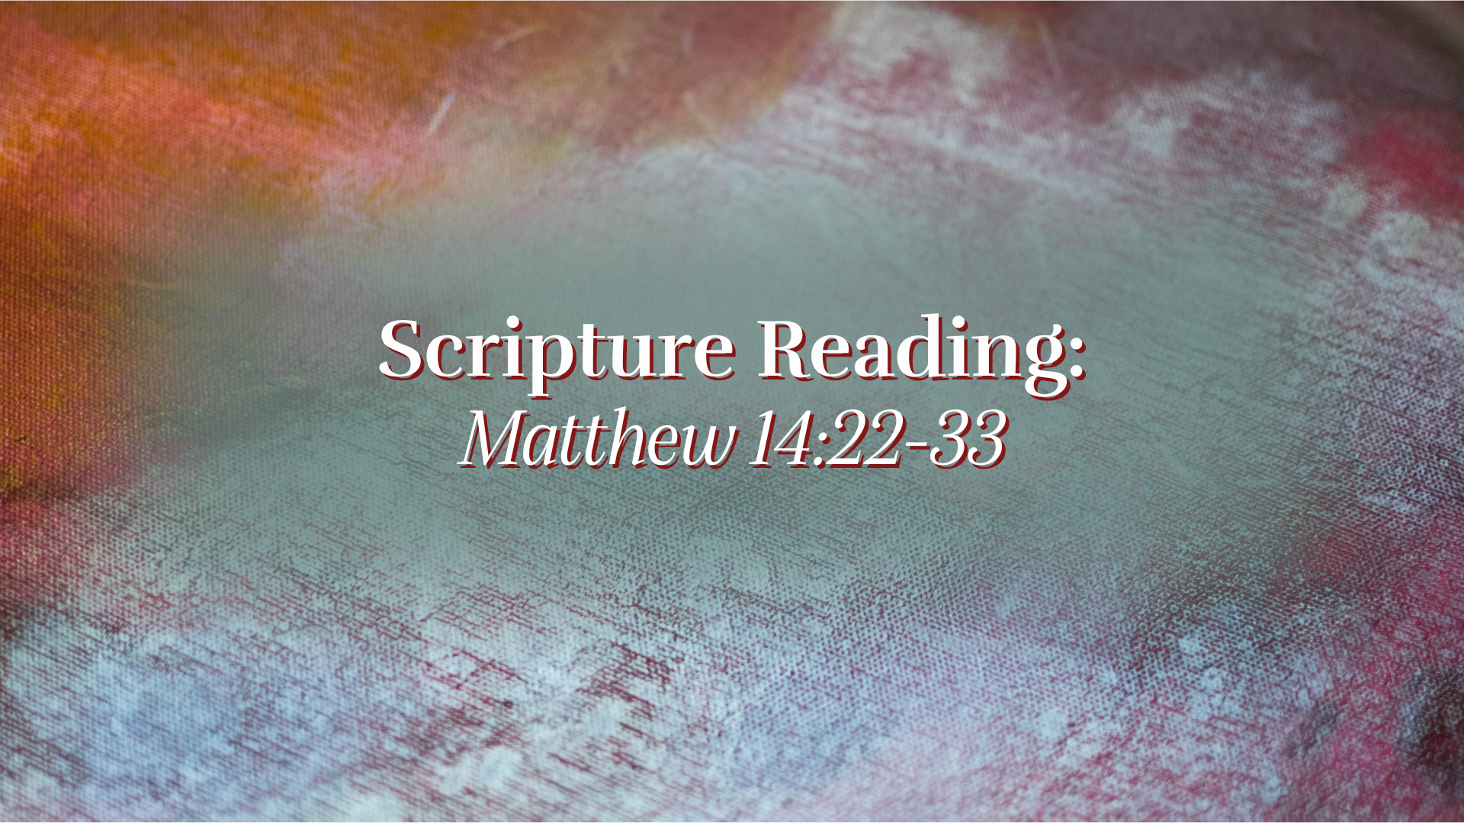
Notes:
Matthew 14:22-33. [INVITE CONGREGATION TO STAND FOR READING]
“This is the word of the Lord. Thanks be to God”
If you’ve been worshipping here at Grantham for a while now, you know that I like movies.
[BRIEF COMMENTS ABOUT MOVIES]
In the third Indiana Jones movie, The Last Crusade (starring Harrison Ford and Sean Connery), there is a memorable scene toward the end of the movie… [NEXT SLIDE]

Slide 6
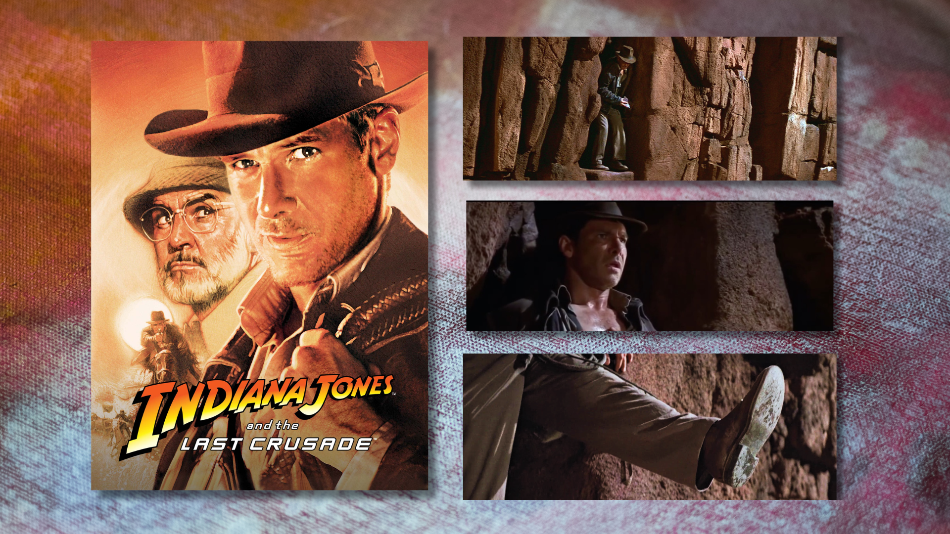
Notes:
A gang of Nazis are racing to find the holy grail for Hitler, which is believed to be the cup that caught the blood of Christ at his crucifixion. They think that anyone who drinks from the cup will receive eternal life. Indiana Jones, with the help of his history-loving dad and friends, are trying to find it first. But they’re captured by the Nazis and his dad (Sean Connery’s character) is shot to motivate Indiana Jones to find the grail for them.
And in order for Indiana Jones to save his dad from dying, he must follow some ancient clues and pass a series of death-defying challenges and tests, which leads up to the climatic test: walking across what appears to be a deep chasm with no visible path. He must take a step of faith and trust that the bridge will appear so he can walk across and acquire the holy grail.
[DESCRIBE THE STEP OF FAITH] --- It reminds me of what the Apostle Paul wrote in 2 Cor. 5:7, he said, “We live by faith, not by sight.” And that’s a lot like what we see happening with Simon Peter in Matthew 14—a man who takes a step of faith and learns a few things in the process. So, let’s return to our Scripture focus for today… [NEXT SLIDE]

Slide 7

Notes:
[READ & COMMENT VERSE-BY-VERSE (14:22-33)]​
There is symbolic meaning in Matthew’s storytelling. Think about it. The boat represents: the disciples together; by extension, the church navigating a hostile world. The storm represents: opposition, fear, uncertainty in the mission. And notice, Jesus seems absent at first, but comes at just the right time; revealing his authority over all chaos. This also becomes a picture of the church’s life: struggling in the storm yet sustained by the presence of Jesus.
I also think it’s important to pay attention to how this episode in the gospels alludes back to events in the history of Israel. Think about that with me by reading God’s word through the prophet Isaiah… [NEXT SLIDE]

Slide 8
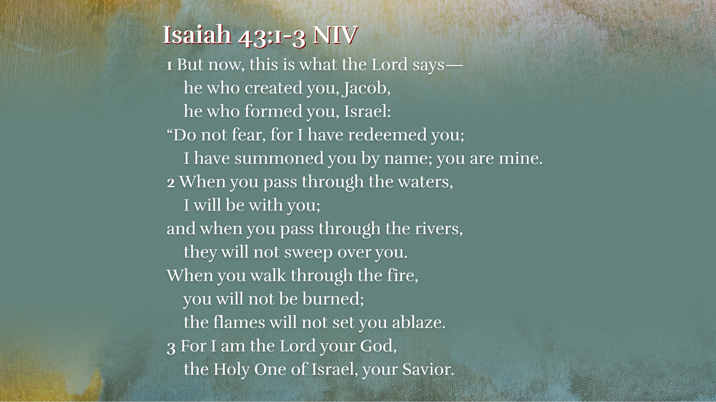
Notes:
[READ & COMMENT]
“pass through the waters” – parted for Moses in the exodus
”pass through the rivers” – parted for Joshua, Elijah, and Elisha
“walk through the fire” – exile was a refining fire (e.g., Dan. 3)
Therefore, the Lord is promising guidance, protection, and, ultimately, deliverance from whatever may come—whatever storms in life, demonic attacks, or enemy opposition—God will not forsake those who are his, and those who call upon him for salvation.
Imagine a father teaching his child to swim. They move from the shallow end toward the deep end. The child hesitates—”Daddy, what if I can’t touch?” The father says, “You don’t need to touch. You just need to trust me.” The child takes a step… slips… and suddenly goes under. But instantly, the father reaches down, grabs him, and lifts him up. “I’ve got you,” he says. “My child, I was never going to let you go.”
That’s Peter. He steps out. He walks. He sinks. And the moment he cries, ‘Lord, save me!’ Jesus immediately reaches out and catches him. And that’s the promise of Isaiah 43. So whatever storm you walked in with today…whatever water feels like it’s rising…whatever fear is pulling your eyes off of Jesus… hear this clearly: you are not alone in the water. And if you feel like you’re sinking—you don’t need a long prayer… you don’t need perfect faith… you just need Peter’s prayer: “Lord, save me.” “Rescue me from danger, Lord.” Because the same Jesus who reached into the waves that night is still reaching for us today. And his grip is stronger than your fear.
Brothers and sisters, You may feel like you’re going under—but you are held by the One who never lets go. Amen? Let’s sum up this message with a few main takeaways… [NEXT SLIDE]

Slide 9

Notes:
Takeaways

Slide 10
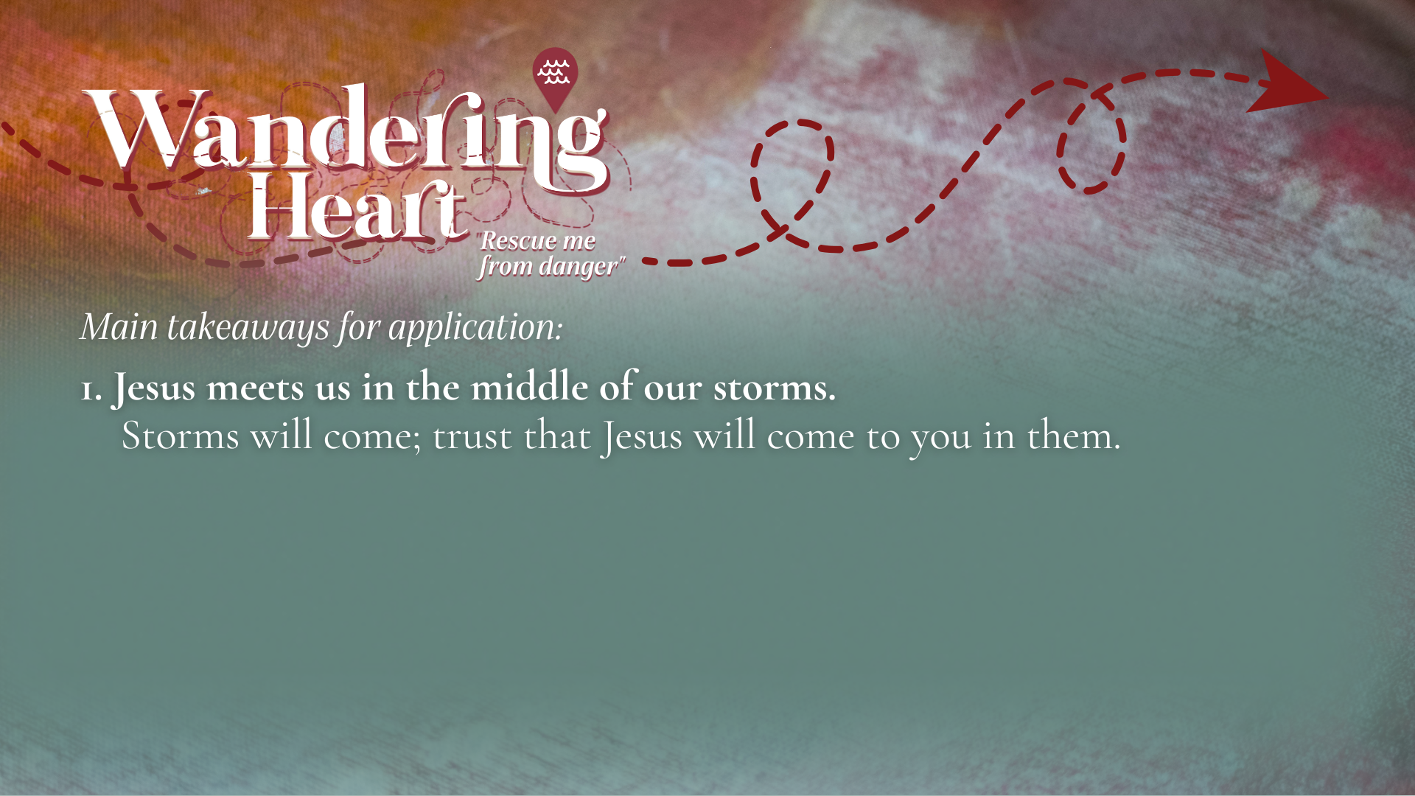

Slide 11
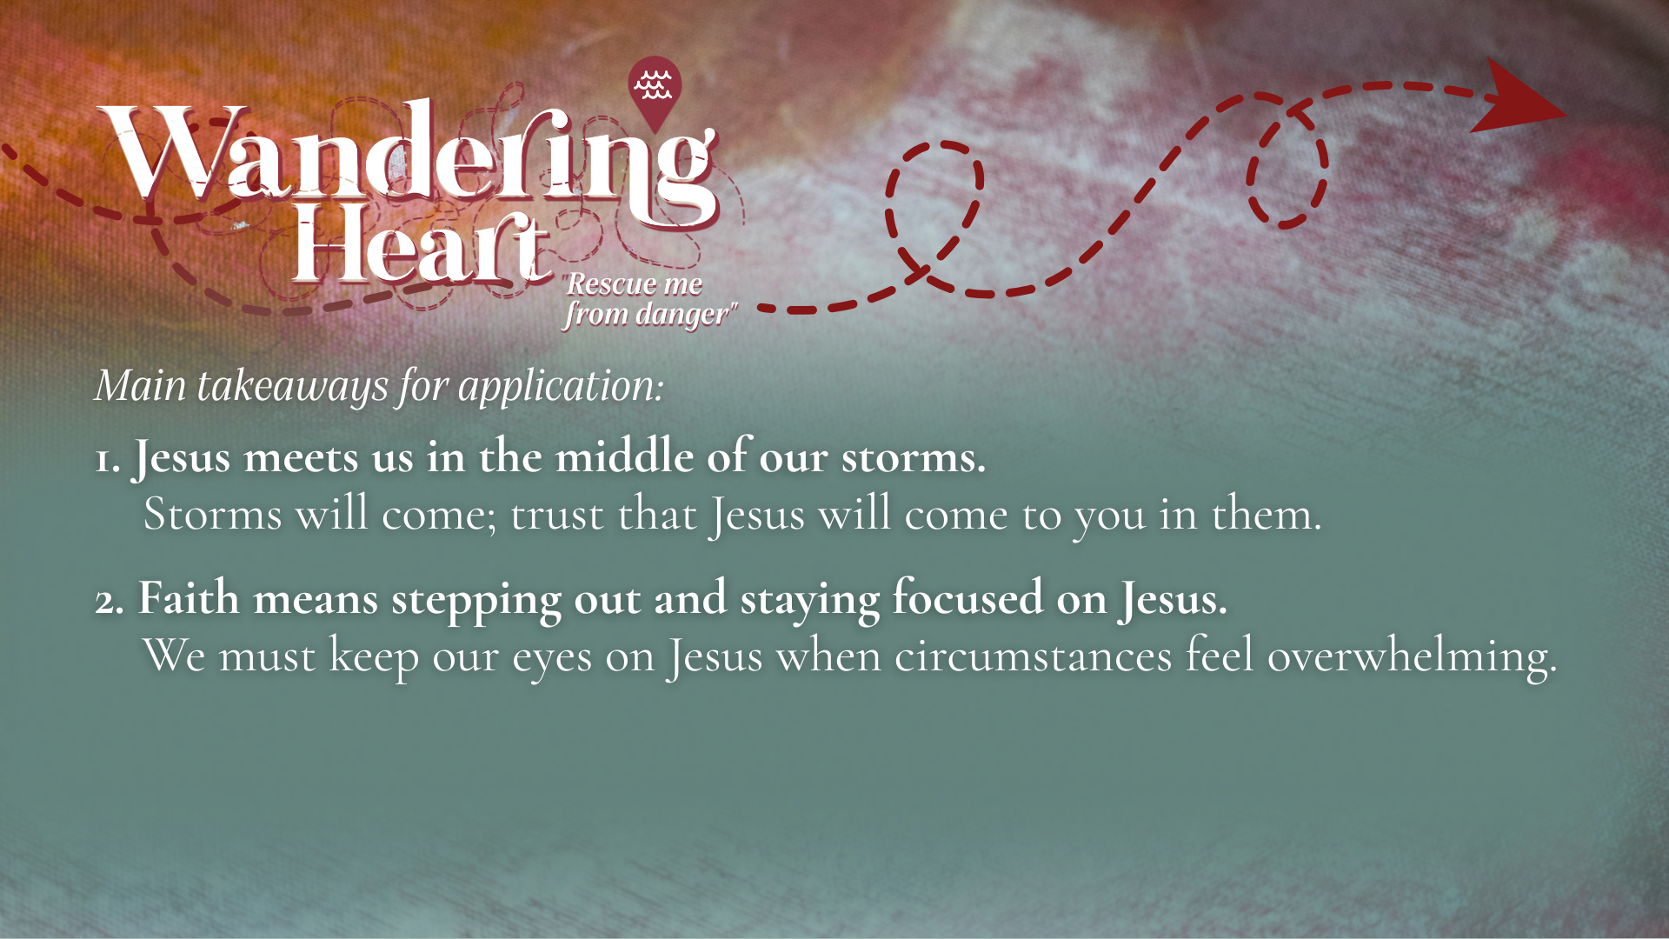

Slide 12
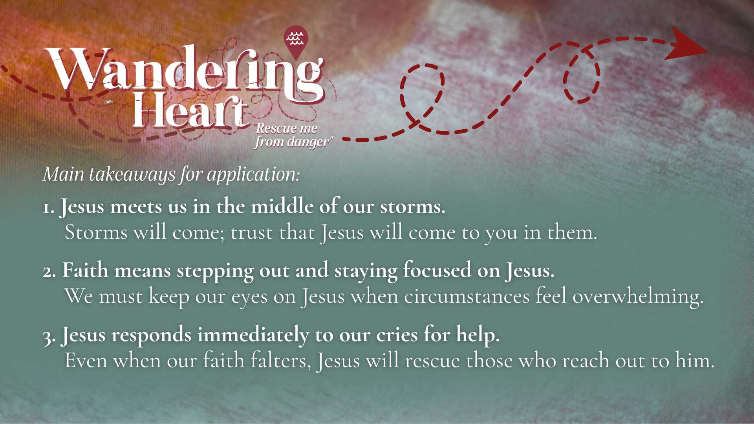
Notes:
[READ TAKEAWAYS & COMMENT ON EACH]
Jesus meets us in the middle of our storms. Storms will come; trust that Jesus will come to you in them. You’re either in a storm, you just come out of one, or you’re bound to go through one soon. Are you cultivating a deeper trust in Jesus? Are you deepening faith in the good days before the storm comes?
Faith means stepping out and staying focused on Jesus. First, as John Ortberg has said, “If you want to walk on water, you’ve got to get out of the boat.” We must be willing to do what seems impossible, because the Lord is with us And secondly, we must keep our eyes on Jesus when circumstances feel overwhelming. Friends, Peter discovered what many of us have discovered: sometimes the most dangerous place isn’t the storm, it’s taking our eyes off Jesus; it’s refusing to trust Jesus in the middle of it.
Jesus responds immediately to our cries for help. Even when our faith falters, Jesus will rescue those who reach out to him. It’s quite amazing, really; how the Lord comes quickly to the aid of the humble and needy. But you’ve got to look up; you’ve got to cry out; “Lord, save me!”
If you attended the ordination service a couple weeks ago, you know that the first sermon I ever preached (when I was 19 years old) was on this story in Matthew 14. So, this episode of Peter getting out of the boat is a reminder to me of my calling and the Lord’s ability to rescue me, no matter what storms may come. And I have an aunt in my family who is an artist; some years ago, she painted this scene and gave it me as a gift… [NEXT SLIDE]

Slide 13
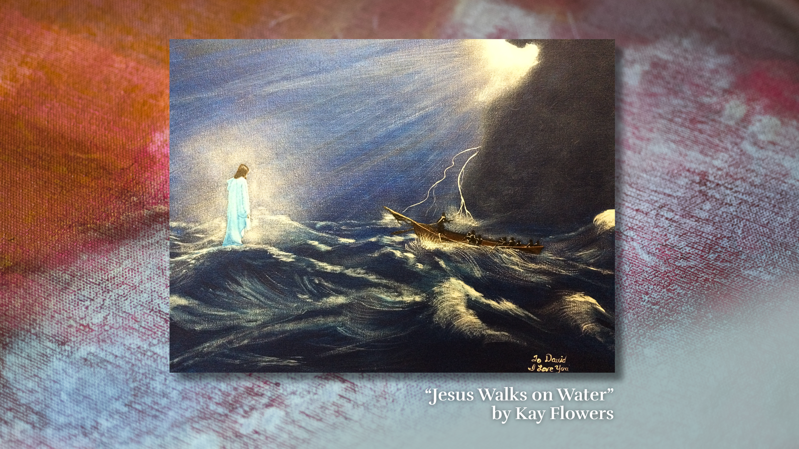
Notes:
[BRIEF COMMENTS]
hanging in my office in front of my desk
Do you need to be reminded of the Lord’s calling on your life and his power over the wind and the waves? Do you know that the Lord comes to you in the storm? Are you courageous enough to get out of the boat and keep your eyes on him? How is the Lord speaking to you?
Maybe you’re in some sort of storm or danger and you need rescued by the Lord. Here is the one response question we want to give you for today’s message… [NEXT SLIDE]

Slide 14
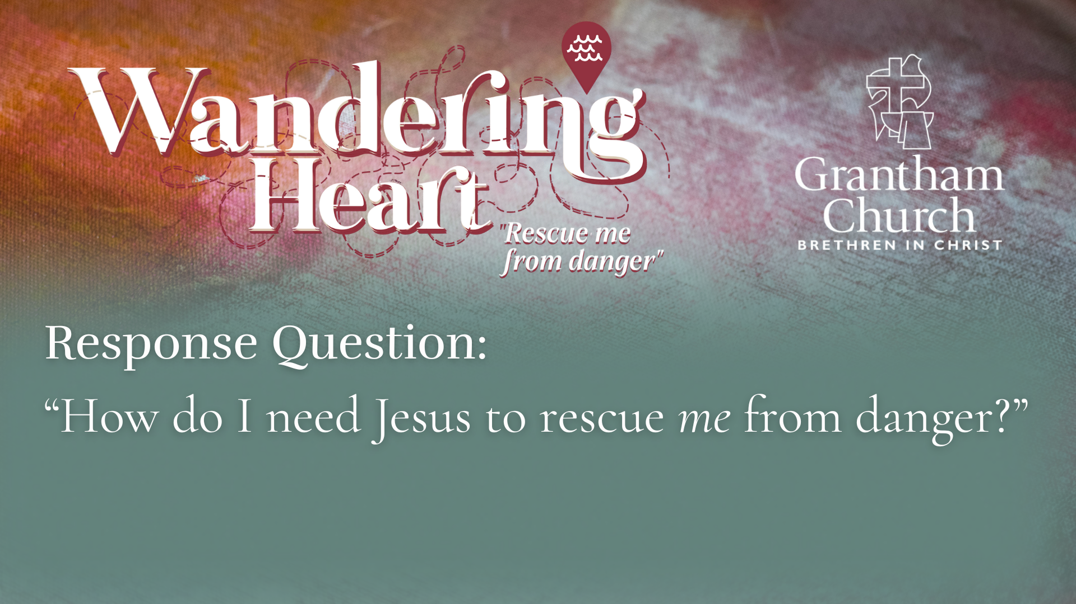
Notes:
Ask yourself… “How do I need Jesus to rescue me from danger?”
[BRIEF COMMENTS]
Question is in the bulletin
[INVTATION TO A MOMENT OF REFLECTION & PRAYER]
“The Hand of God” by Korean Artist: Yongsung Kim
Let’s gaze upon this work of art, reflect, and listen for the Lord’s voice… [NEXT SLIDE]

Slide 15
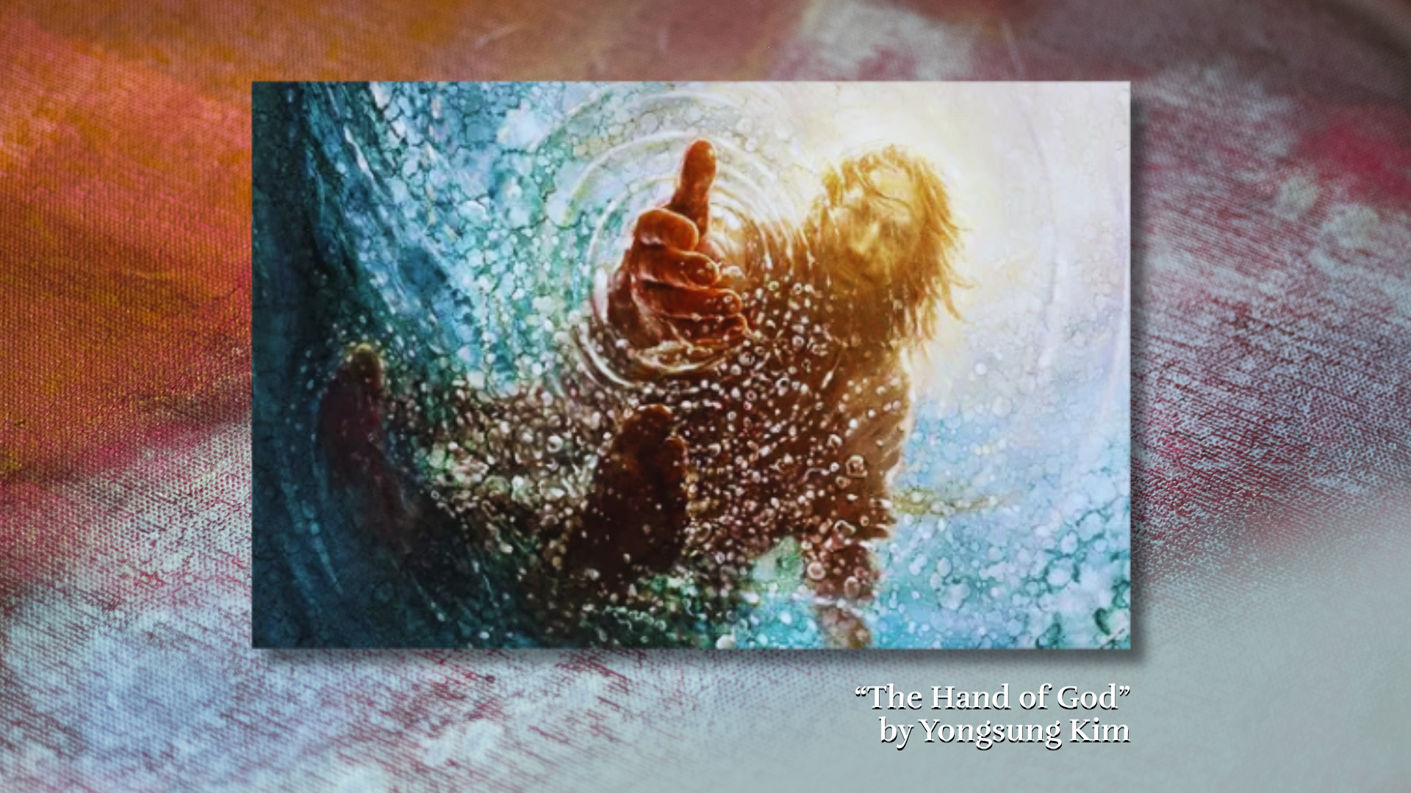
Notes:
[GIVE PEOPLE A MOMENT FOR REFLECTION & PRAYER]
[GO TO NEXT SLIDE FOR CLOSING PRAYER]

Slide 16

Notes:
REFLECTION SONG, APOSTLES’ CREED, COMMUNION
ANNOUNCEMENT: College Student Lunch
Benediction
Beloved wanderer, as you leave this place,
may you carry your curious heart on your sleeve.
May you look for God in every face.
May you find the courage to get out of the boat,
to run to the tomb, and to speak of your faith.
And when the world falls apart,
may you hear God’s voice deep within,
saying, “Take heart, it is I, be not afraid.”
You are called. You are blessed.
In both your ups and your downs,
you always belong to God.
Go now in peace.
Go trusting that good news.
Amen.

